Slide 1


FitFlex: Your Personal Fitness Companion
Revolutionizing Your Workout. Discover FitFlex, the ultimate fitness companion. Designed to help you achieve your health goals. Get ready to transform your fitness journey. Unlock a personalized experience today.
Notes:
1

Slide 2
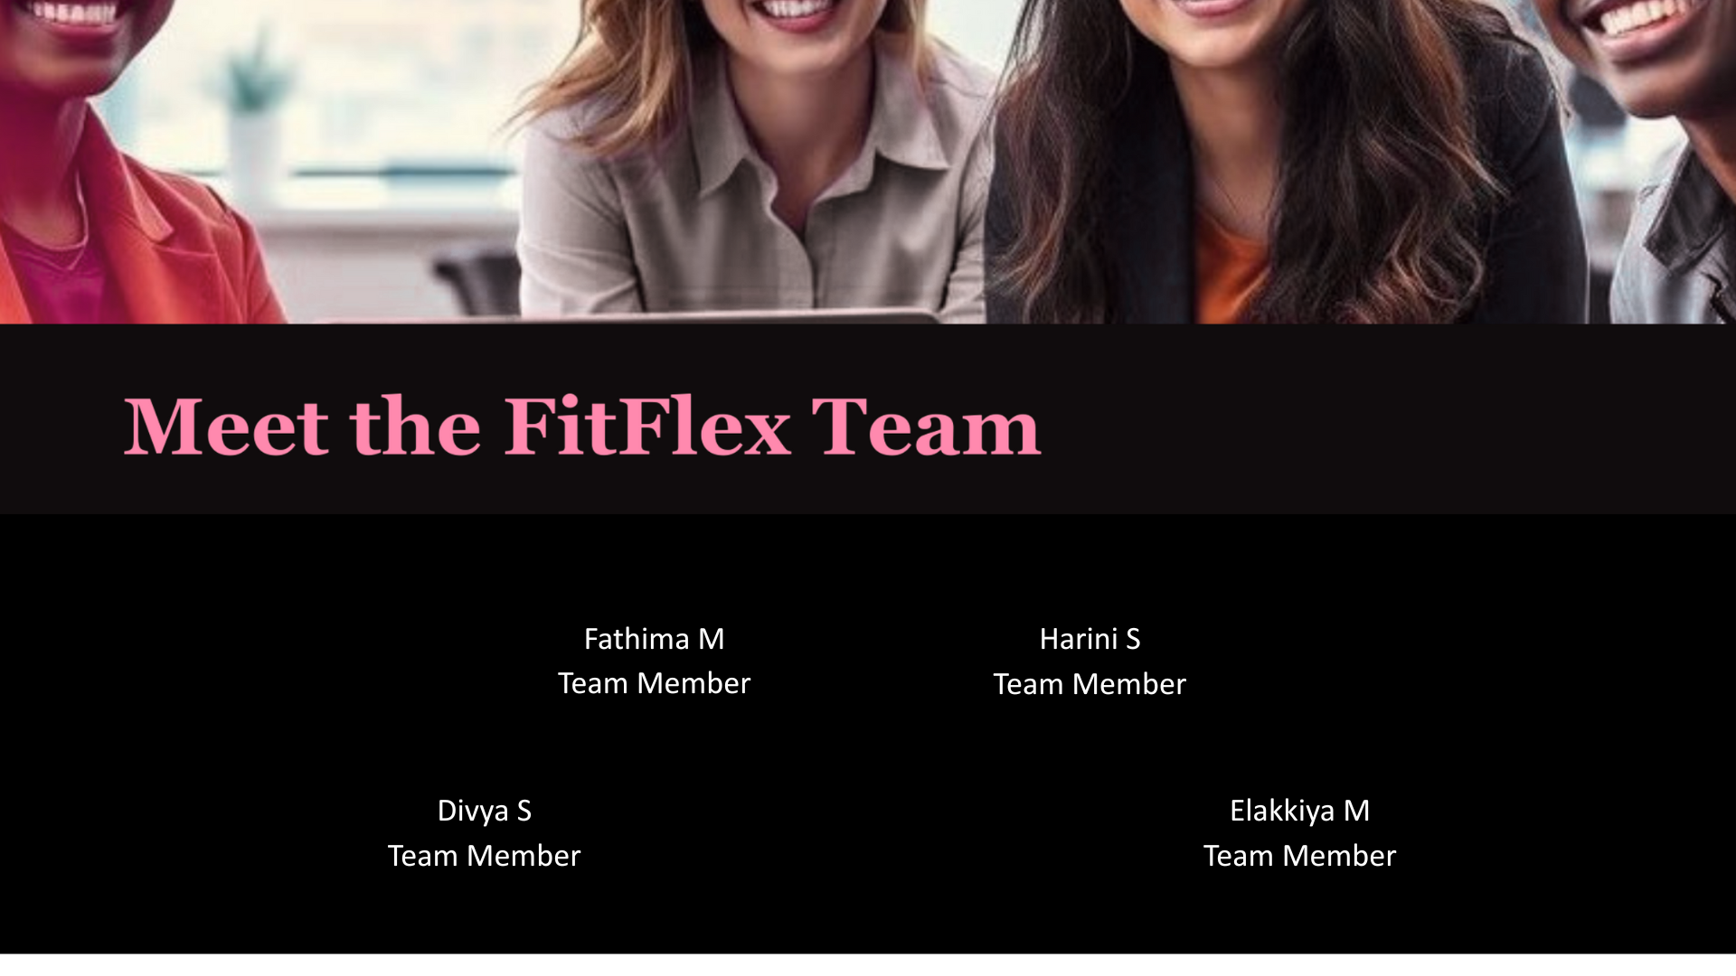
'km
,,f'kdfm
/ermf;fke'''''fk'qq
p

Slide 3


Introduction: Your Personalized Fitness Journey
Meet FitFlex
Personalized for You
The fitness app that adapts to you.
Customized workouts tailored to your needs.
Track Your Progress
Monitor your achievements and stay motivated.
Notes:
2

Slide 4
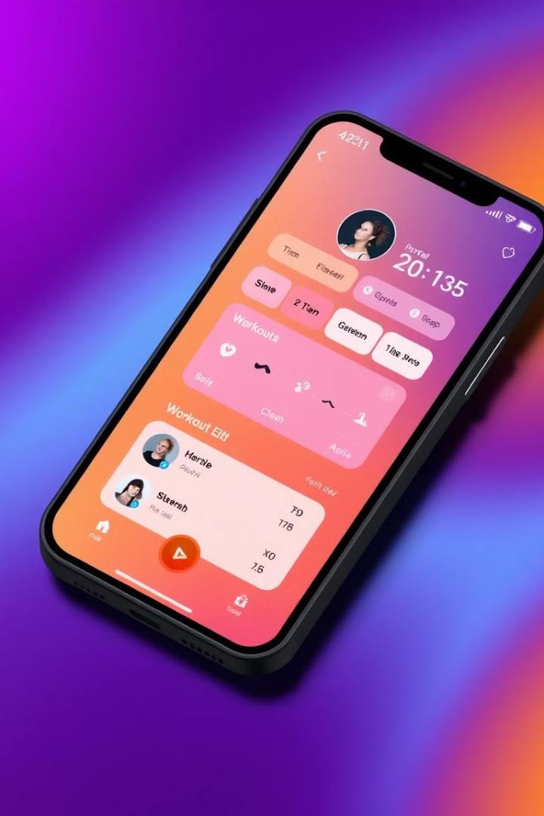
What is FitFlex?
Your Personal Companion
Achieve Your Goals
A comprehensive fitness app.
Your AI powered fitness journey starts here.
Anytime, Anywhere
Your training partner to make you feel amazing.
Notes:
3

Slide 5
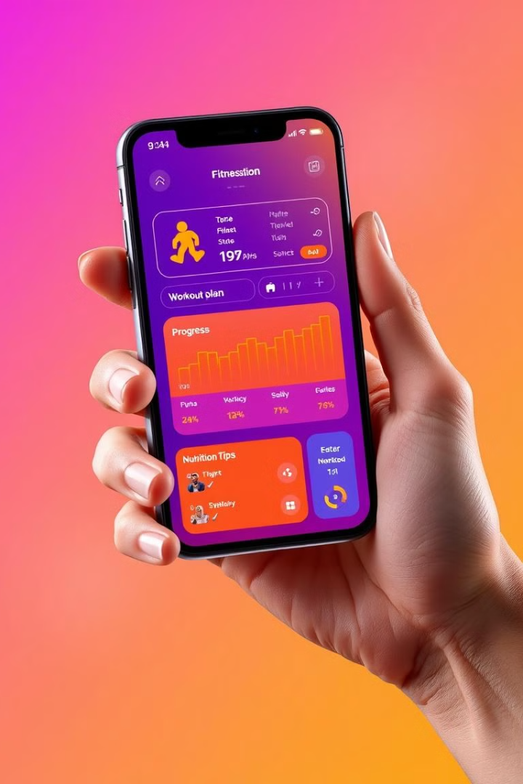



Key Features
Personalized Plans
Customized workout regimens designed for you.
Progress Tracking
Monitor your fitness journey in real time.
Nutrition Guidance
Expert tips to fuel your body for optimal results.
Notes:
4

Slide 6
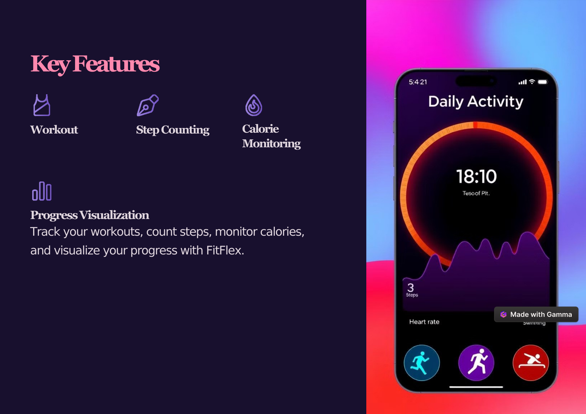

Slide 7
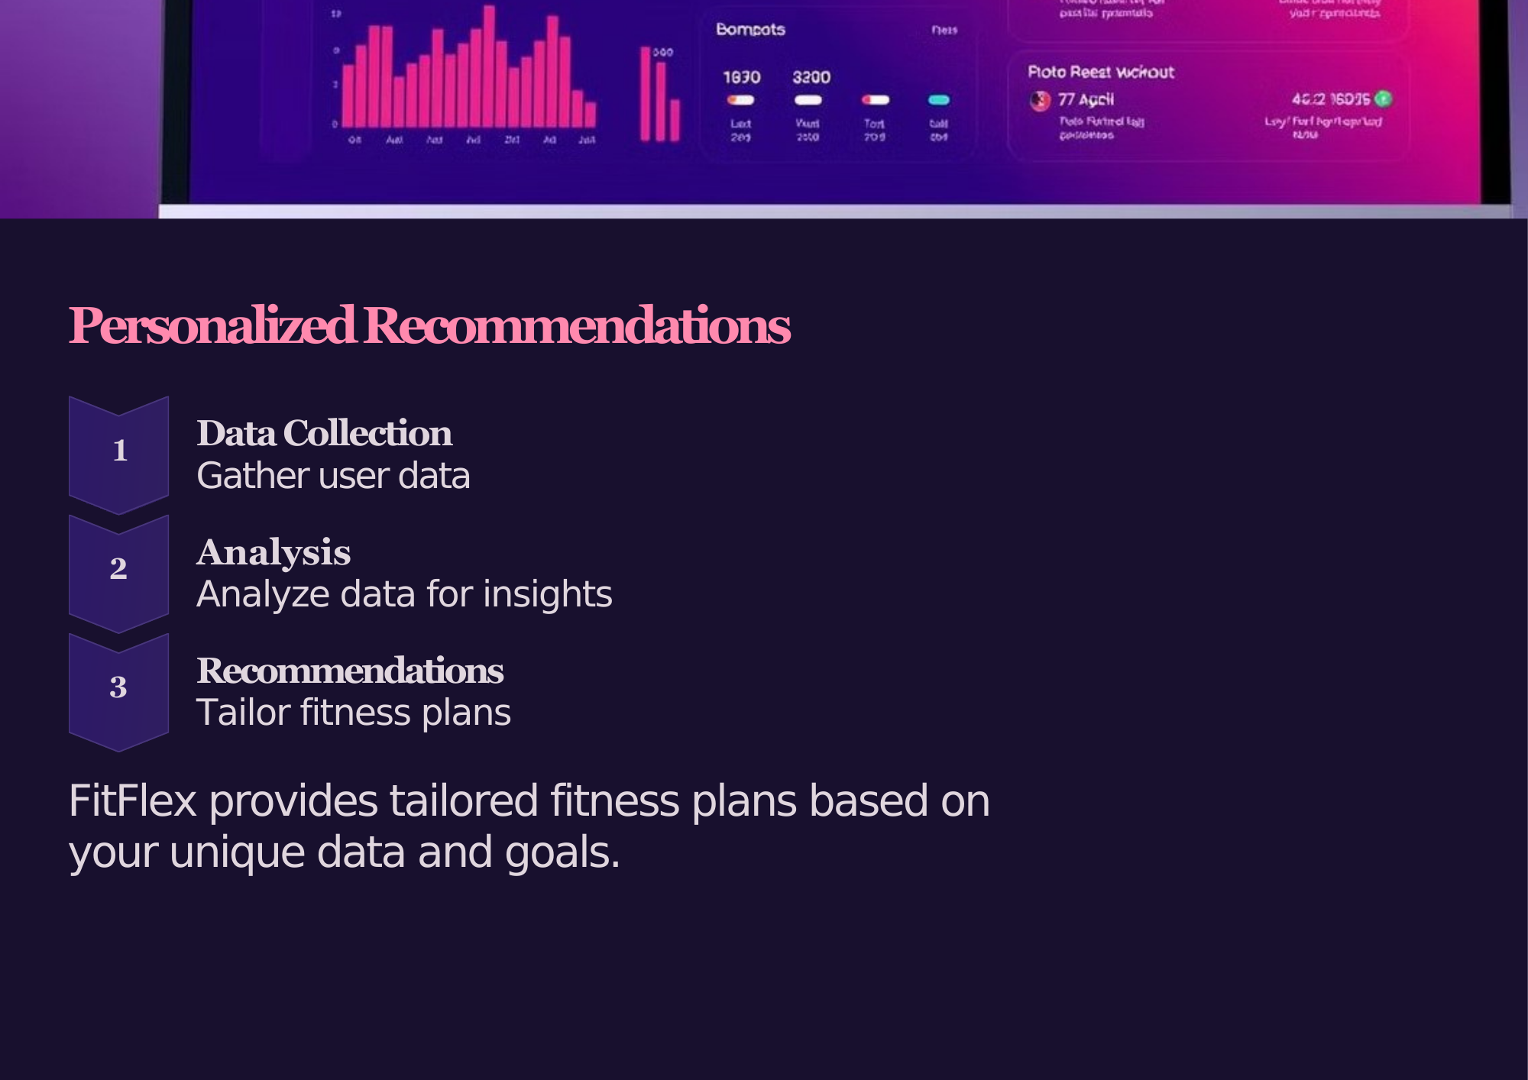

Slide 8




Technology Used
AI Algorithms
Advanced machine learning for personalized workouts.
Cloud Storage
Securely store your data.
Cross-Platform
Available on iOS and Android devices.
Notes:
5

Slide 9
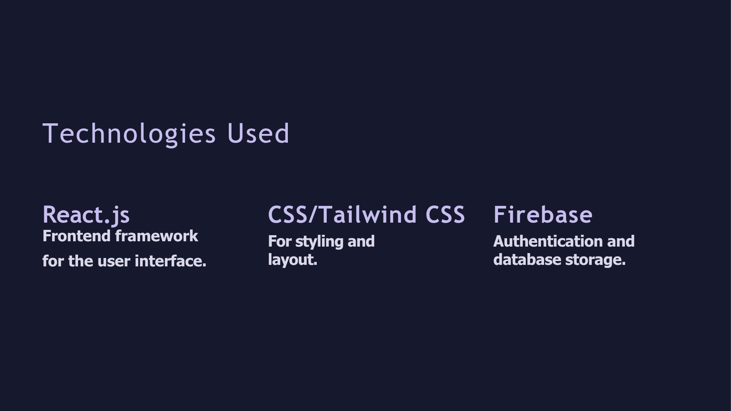

Slide 10
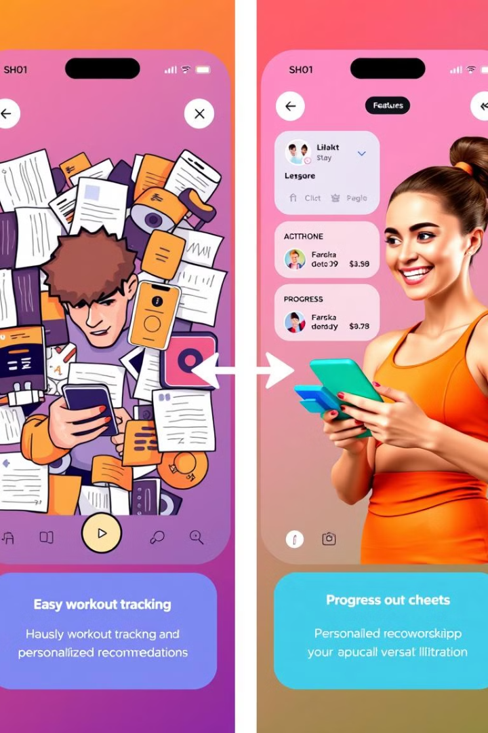



User Interface (UI) & User Experience (UX)
Intuitive Design
Easy-to-navigate interface for all users.
User-Centric
Designed with user feedback.
Engaging Experience
Motivating and fun to use.
Notes:
6

Slide 11




Target Audience
1
Fitness Enthusiasts
2
Beginners
3
Busy Professionals
4
Health Conscious
FitFlex caters to diverse individuals seeking convenient, personalized fitness solutions.
Notes:
7

Slide 12
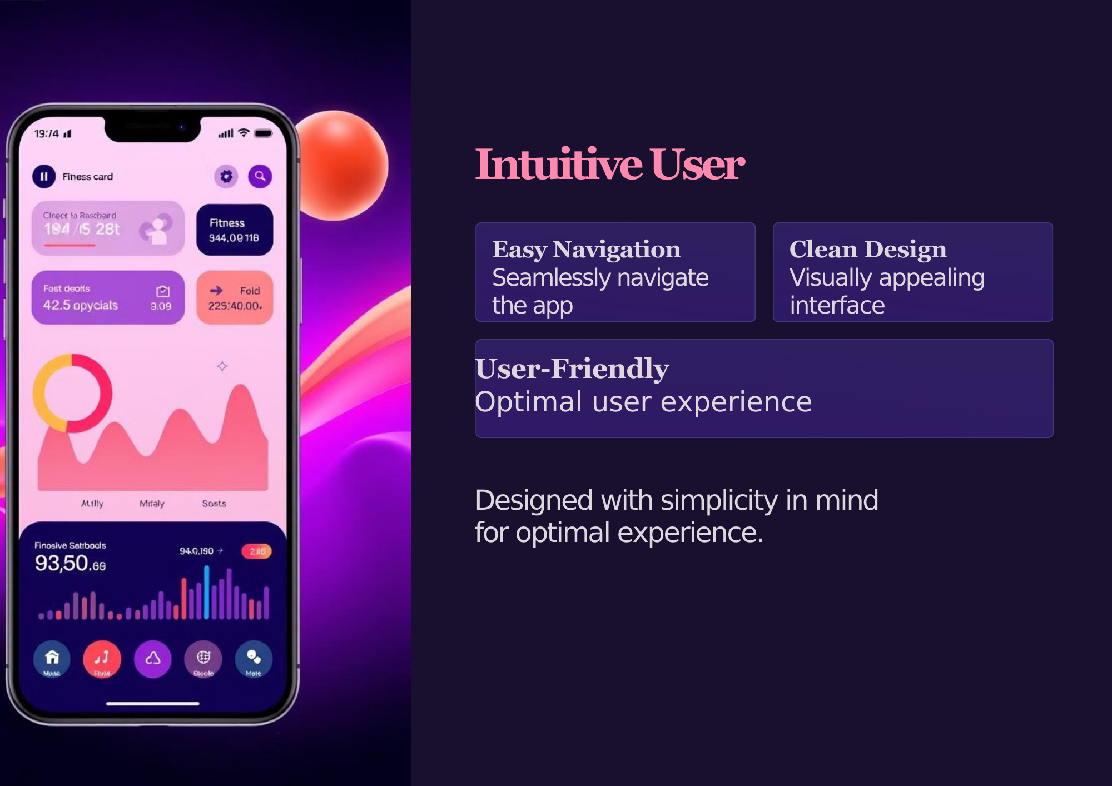

Slide 13








Marketing Strategy
Social Media
Influencer
Engage with our audience daily.
Partnerships for a wider reach.
SEO Optimization
Email Marketing
Improving online visibility.
Targeted campaigns.
Notes:
8

Slide 14



Future Development
VR Integration
Immersive workout experience.
AI Coach
Smart insights and feedback.
Advanced Analytics
Detailed performance metrics.
Notes:
10

Slide 15
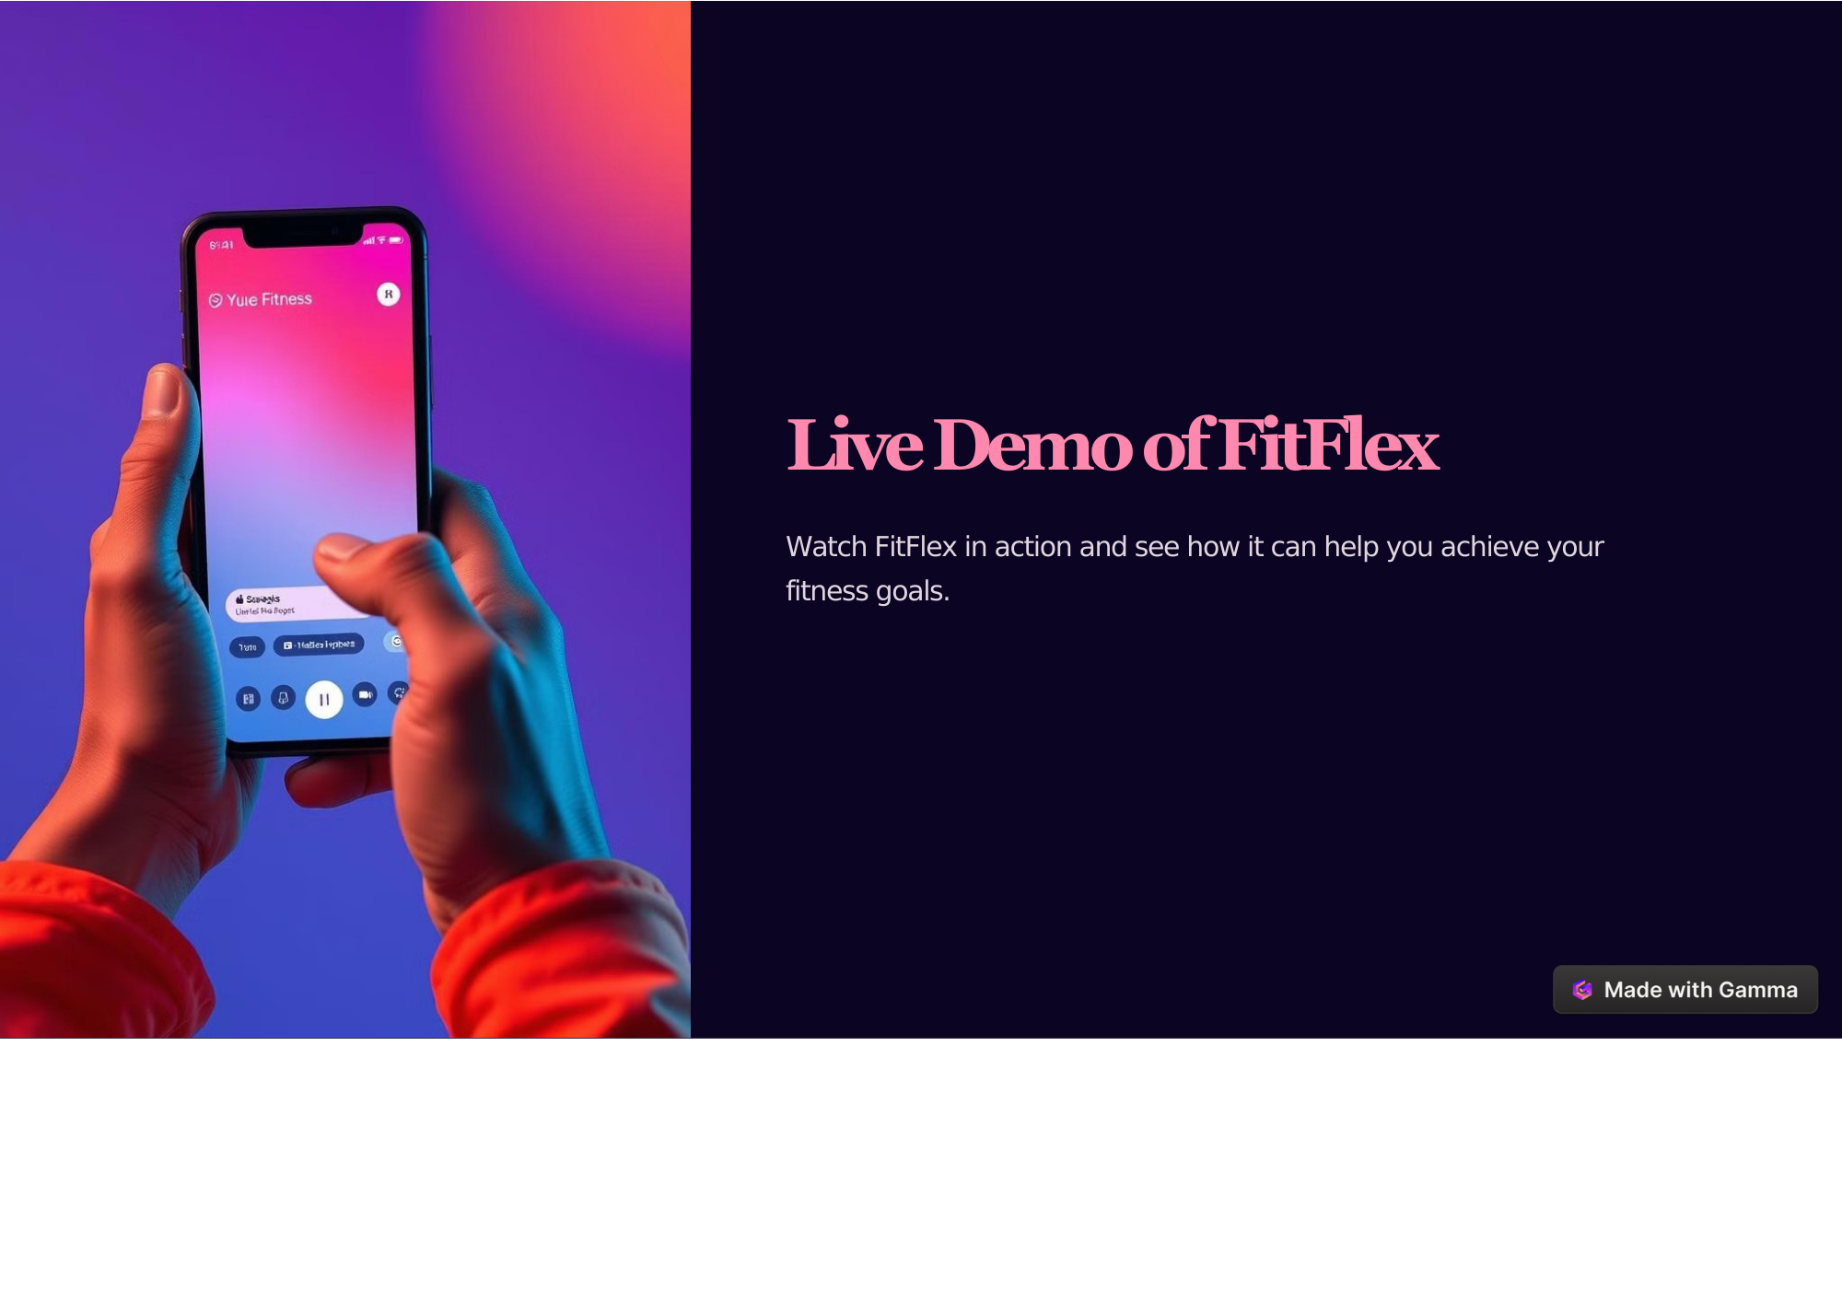

Slide 16
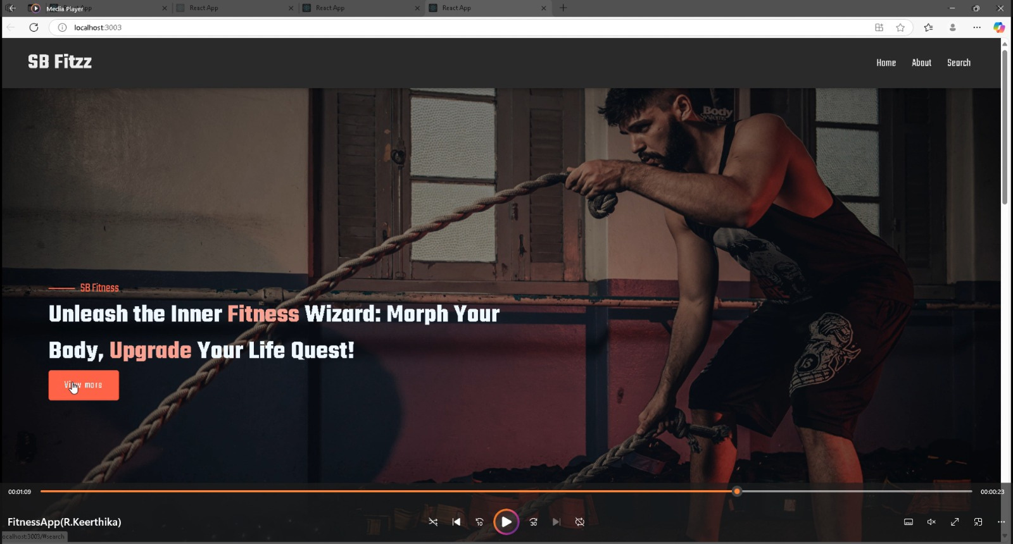

Slide 17
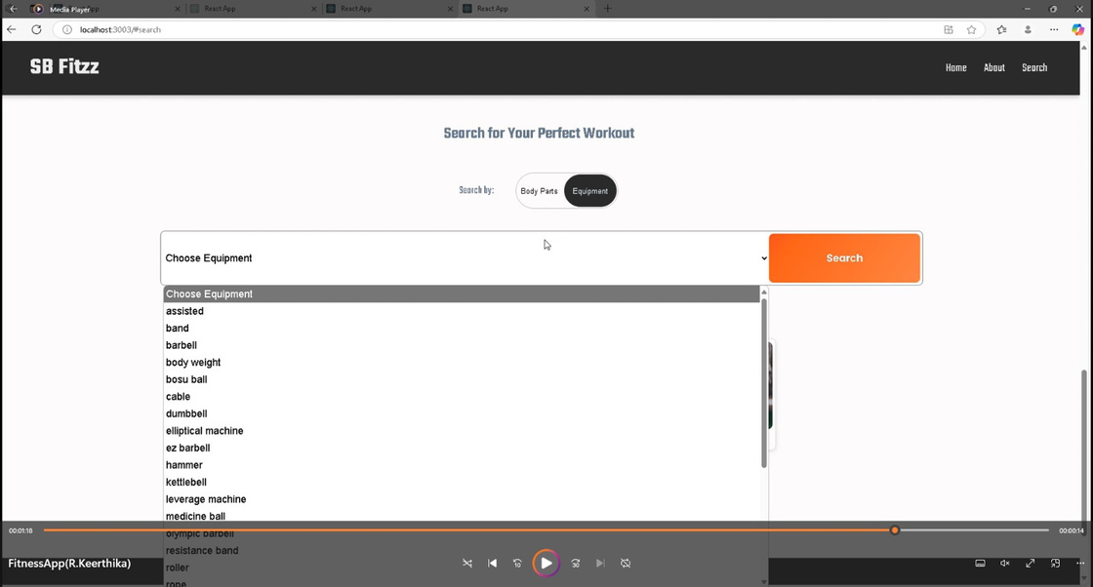
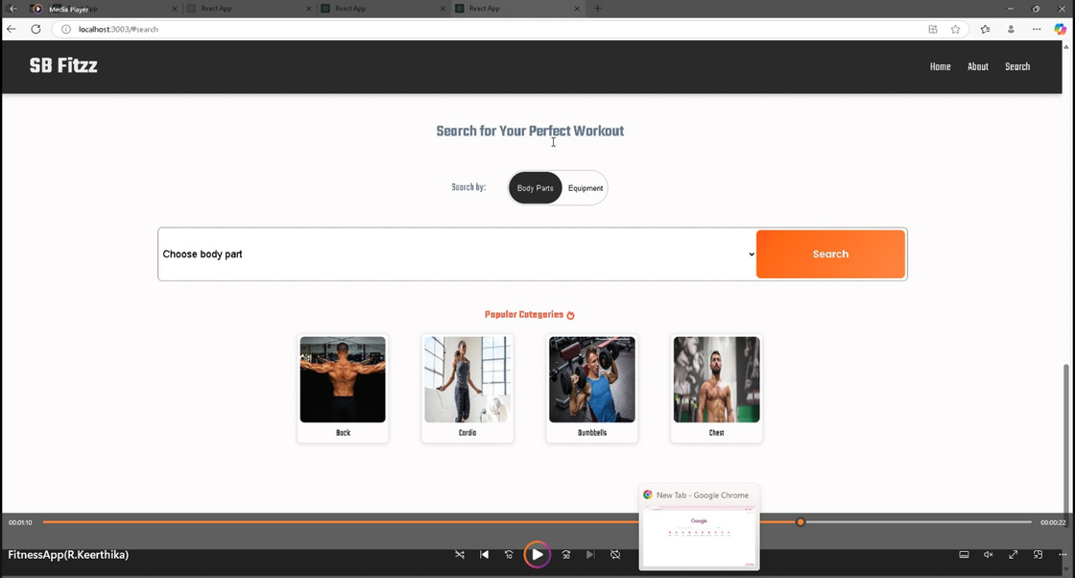

Slide 18
FitFlex: Your Personal Fitness Companion
https://github.com/Fathima-2407/Fitflex-
Notes:
1

Slide 19
THANK YOU
FitFlex: Your Fitness Personal Companion
Notes:
1

